Slide 1
Advanced Research WRF (NCAR)

Slide 2
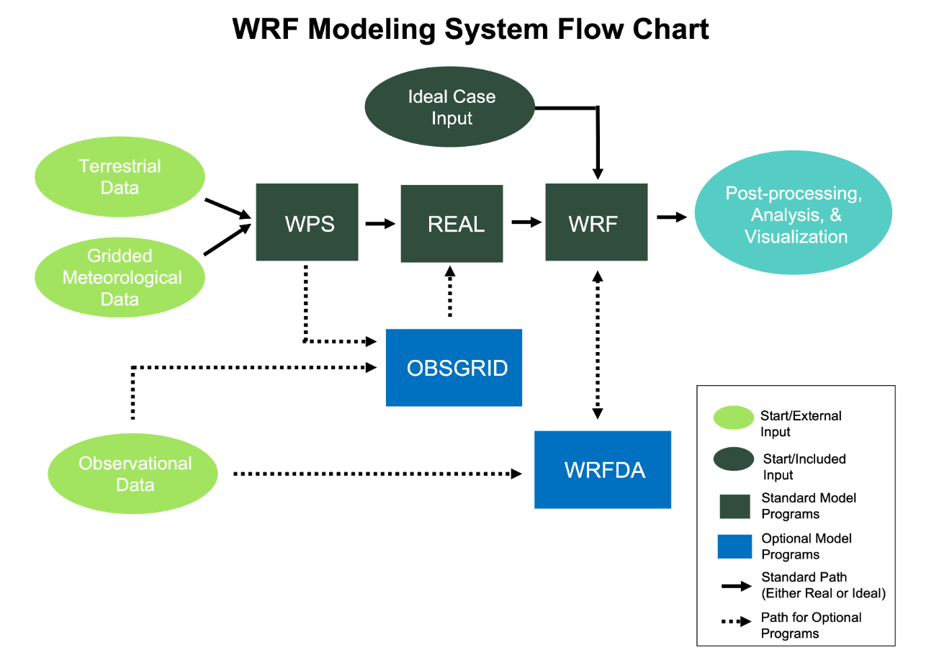
Overview: 1. WRF Model System Components
WRF Preprocessing System (WPS)
define simulation domains;
interpolate terrestrial data (e.g., terrain, landuse, and soil types) to the simulation domain;
ungrib and interpolate meteorological input data from an outside model to the simulation domain.

Slide 3
Overview: 1. WRF Model System Components
WRF-ARW Solver
A fully compressible, nonhydrostatic model with a hybrid vertical hydrostatic pressure coordinate (HVC).
Arakawa C-grid staggering.
Uses the Runge-Kutta 2nd and 3rd order time integration schemes, and 2nd to 6th order advection schemes in both the horizontal and vertical.

Slide 4
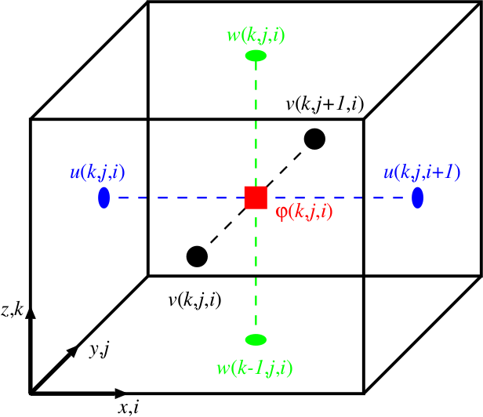
Dynamics
ARW-WRF uses a dynamical solver to perform time and space integration of the equations of motion.
The WRF model uses a hybrid terrain-following mass coordinate system. It employs a 5th order horizontal advection option, 3rd-order vertical advection, and a 3rd-order Runge-Kutta time integration scheme.
Notes:
Since the equations cannot be solved analytically, they are discretized on a grid and computed for approximate solutions.
Grid-staggering is done on a C-grid, where U and V are calculated on the west/east (U) and south/north (V) interfaces of each grid cell. Vertical motion is calculated at the bottom and top interfaces of grid cells. All other variables are processed in the center (mass) point of each grid.

Slide 5
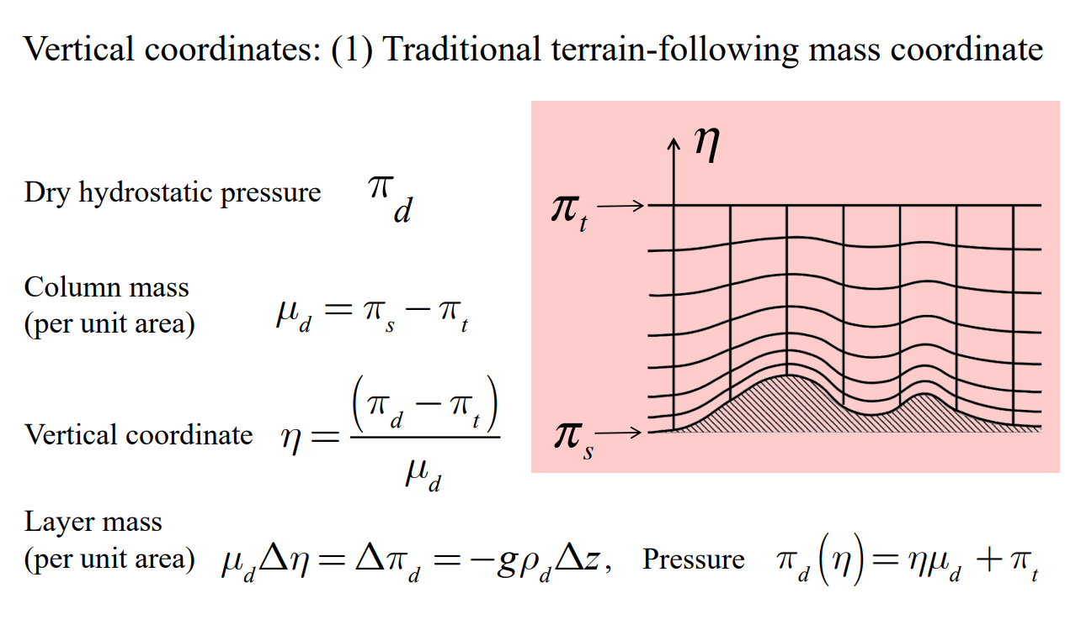
Dynamics: 1. Vertical mass coordinate

Slide 6
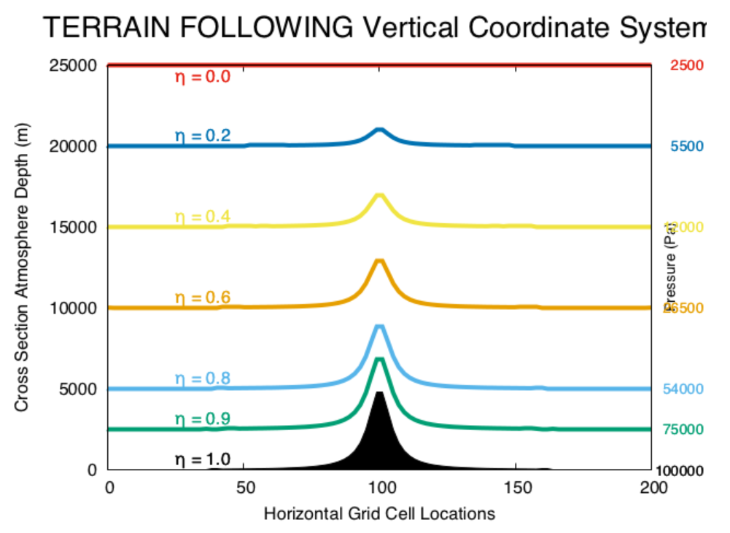
Dynamics: 1. Vertical mass coordinate

Slide 7
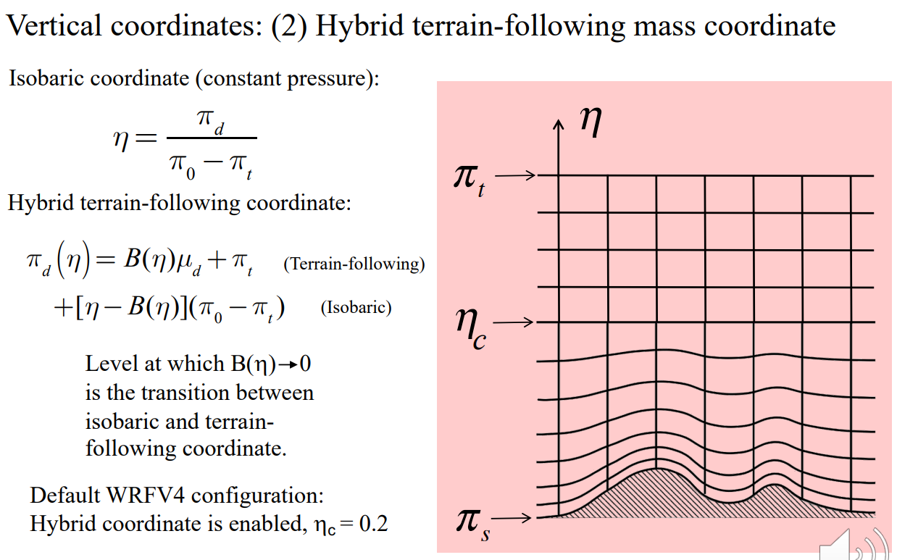
Dynamics: 1. Vertical mass coordinate

Slide 8
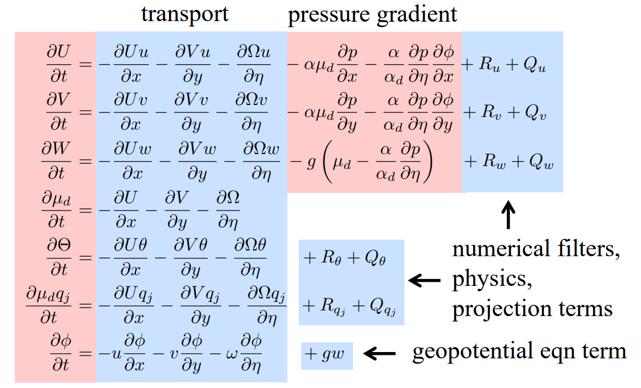
Dynamics: 3. Model Governing Equations
Momentum X-component
Momentum Y-component
Momentum Z-component
Conservation of Mass
Conservation of Heat
Diagnostic Hydrostatic
Geopotential Height

Slide 9
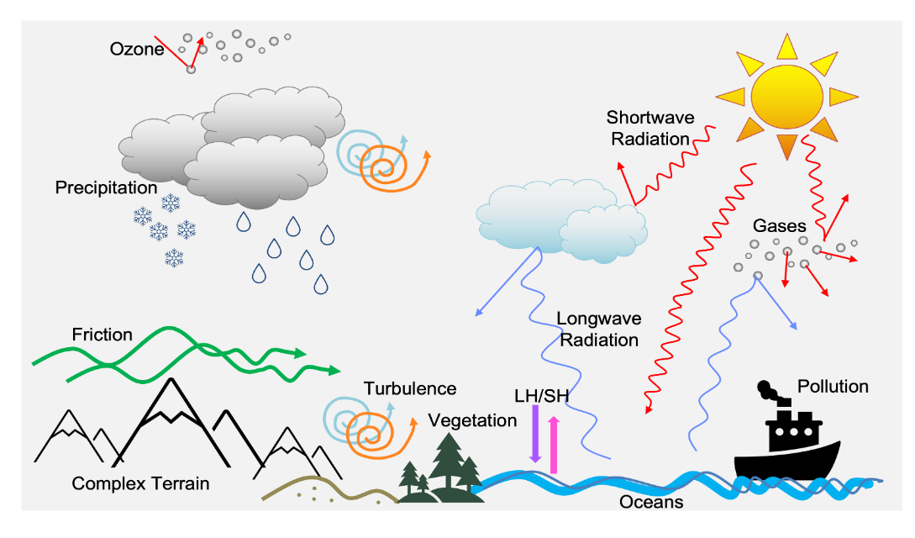
Physics
Numerous physical processes take place in the Earth’s atmosphere.
Sun emits shortwave
Earth/Ocean reflects longwave
Heating creates boundary layer
Cloud precipitates in many forms (such as rain, snow, and graupel).
Aerosol/chemical forcings

Slide 10
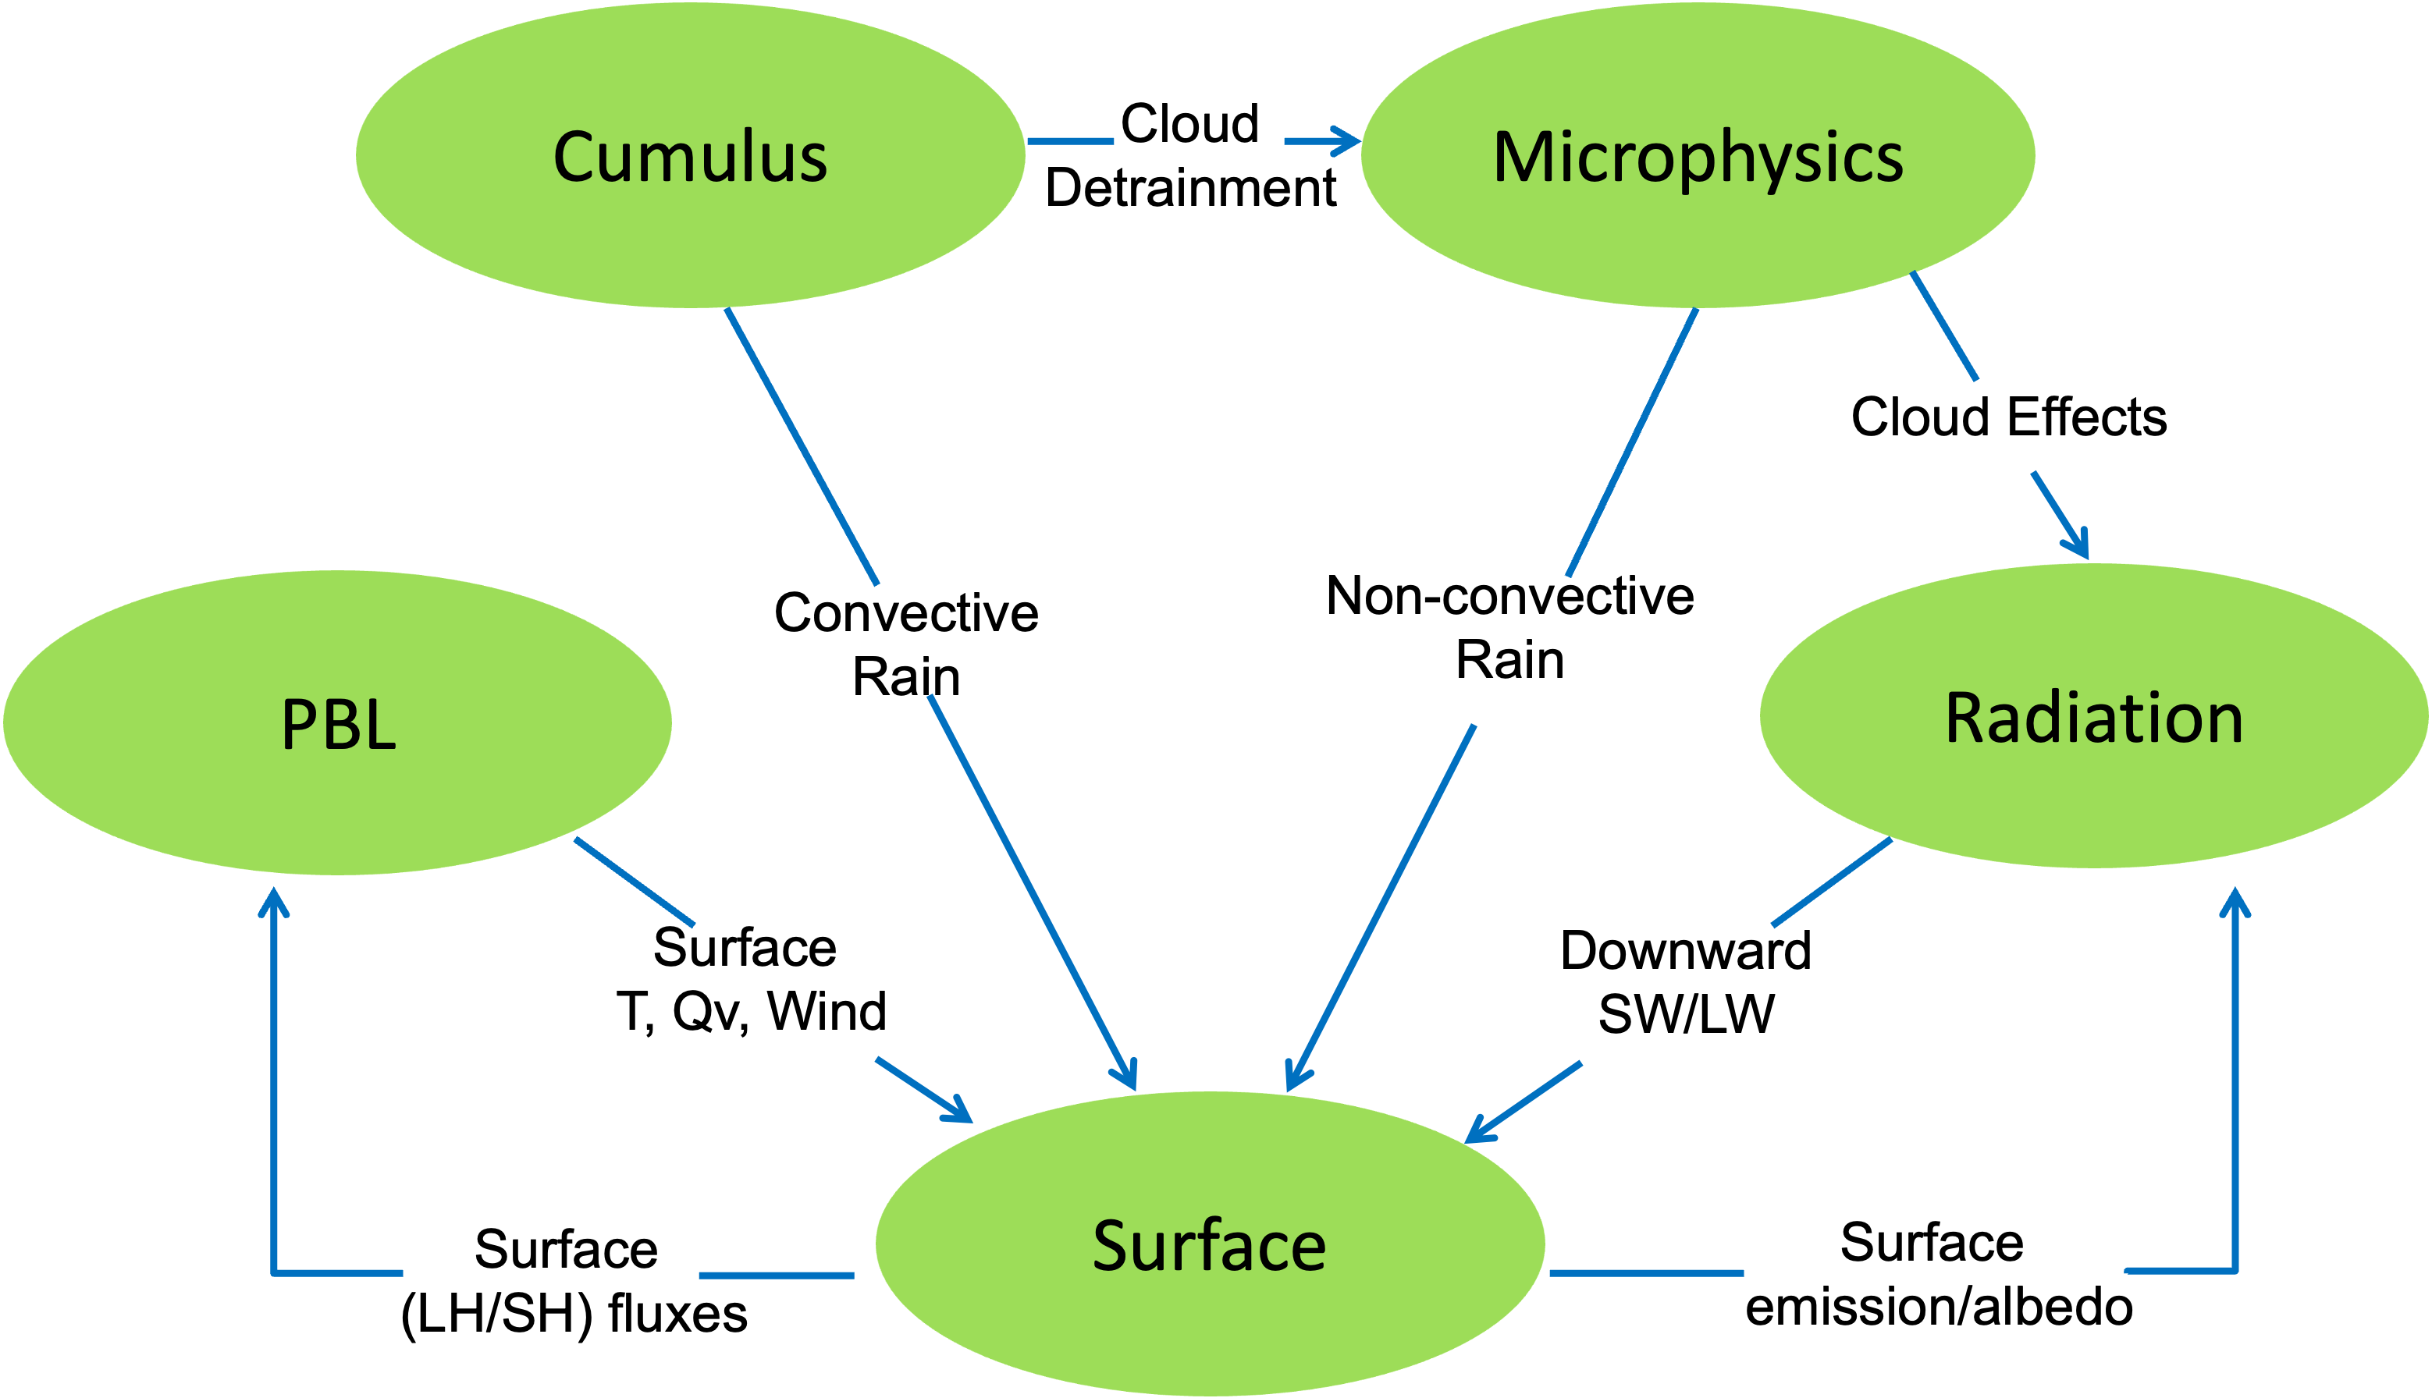
Physics: all schemes interact with each other

Slide 11
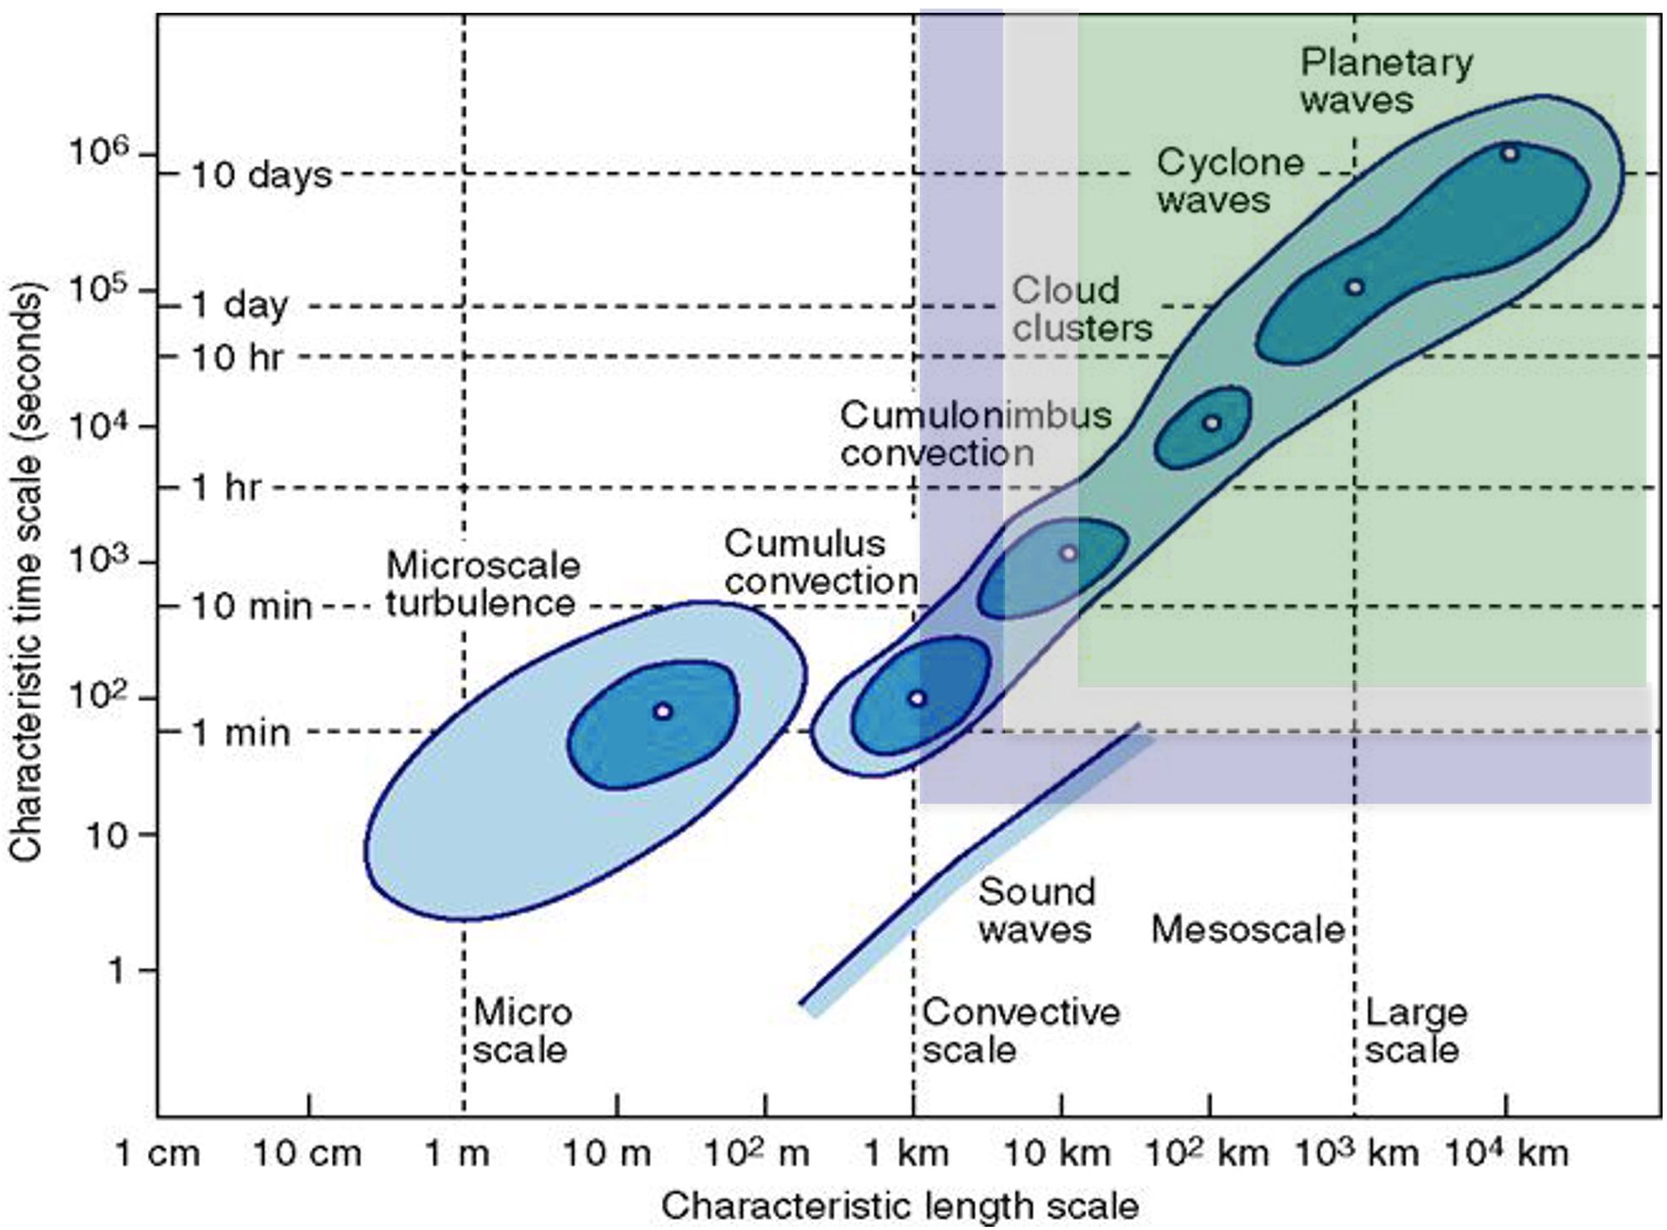
Physics: 1. Cumulus
They all parameterize sub-grid-scale effects of convective and shallow clouds.
Cumulus parameterization schemes (CPS) provide a representation of shallow and deep cumulus clouds and are an integral component in simulating precipitation.

Slide 12
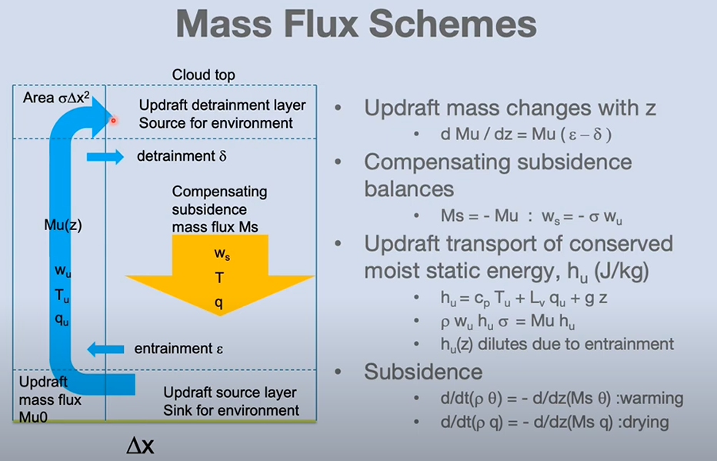
Physics: 1. Cumulus
Redistributes air column to account for vertical convective fluxes
Updrafts take tropospheric air upwards
Downdrafts takes mid-level air downwards
Cu scheme needs to accurately determine
When to trigger convective column?
How fast to make the convection act?

Slide 13
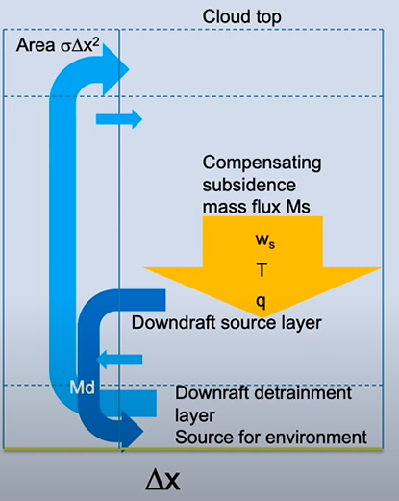
Physics: 1. Cumulus
Updrafts
Driven by buoyancy
Moist air to upper troposphere
Condensation to convective rainfall
Downdrafts
Driven by convective rain evaporation
Evaporatively cooled air to boundary layer
Subsidence
Warms and dries troposphere
Main warming effect in column

Slide 14
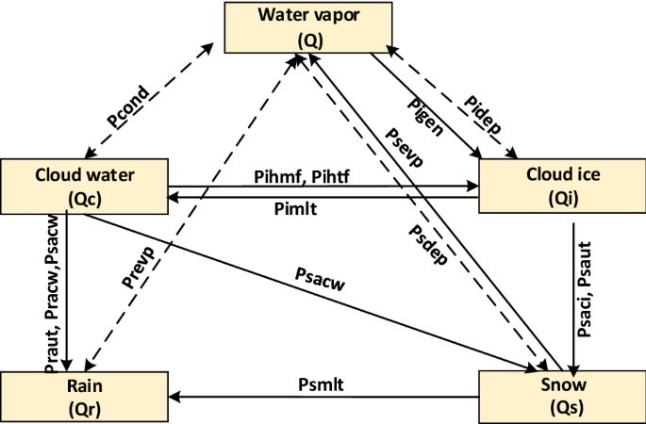
Physics: 2. Microphysics
WRF microphysics schemes resolve cloud and precipitation processes.
It provides atmospheric heat and moisture tendencies to the model, and the resolved-scale (or NON-convective) rainfall at the surface.

Slide 15
Rainfall output
Cumulus and Microphysics can be run at the same time
ARW outputs rainfall accumulation since simulation start time (0 hr) in mm.
RAINC comes from cumulus scheme
RAINNC comes from microphysics scheme
Total is RAINC + RAINNC
RAINNCV is time-step value
SNOWNC/SNOWNCV are snow subset of RAINC/RAINNCV

Slide 16
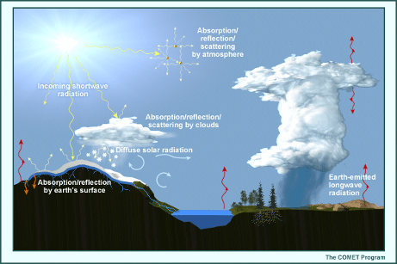
Physics: 3. Radiation
WRF radiation schemes obtain cloud properties from the microphysics scheme, and then compute an atmospheric temperature tendency profile, as well as surface radiative fluxes, due to longwave and shortwave radiation.

Slide 17
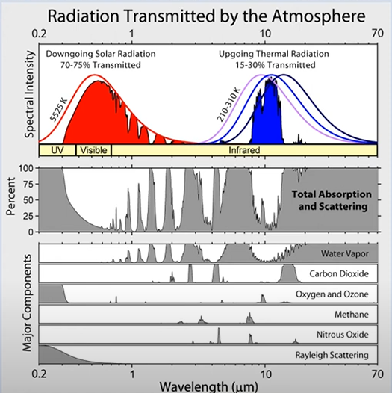
Radiation effects in clear sky
Longwave effects mainly come from water vapor, CO2
Shortwave effects mainly come from O2 and O3
Shortwave radiation is incoming solar radiation; Longwave radiation is emitted from Earth.

Slide 18
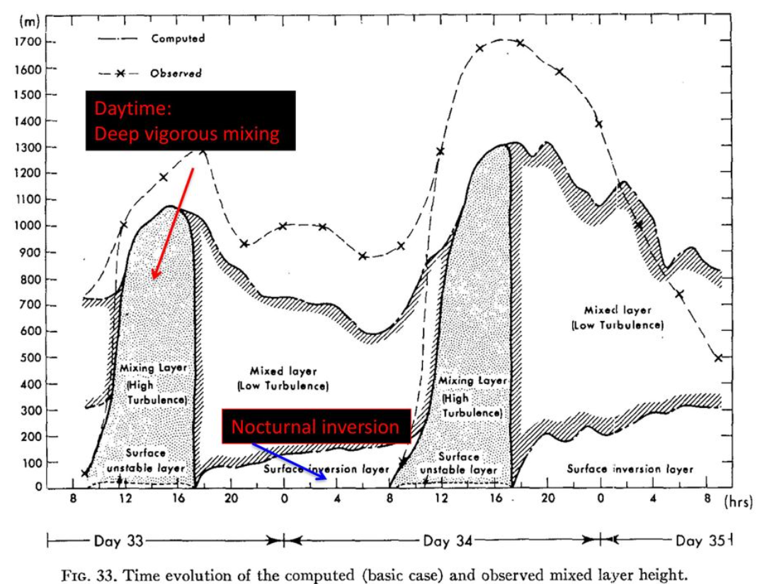
Physics: 4. PBL
Bottom layer of the troposphere.
Strong diurnal cycle.
PBLH varies from tens of m to several km.
Interacts with the surface layer.
(Yamada and Mellor, 1975)

Slide 19
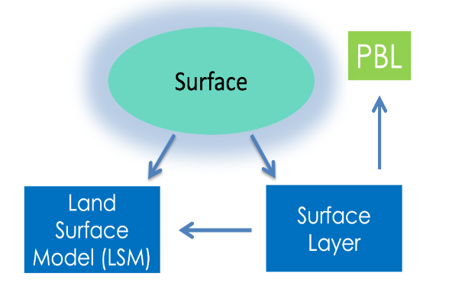
Physics: 5. Surface
Surface layer (sfclay) schemes determine surface layer diagnostics, which includes exchange and transfer coefficients.
for heat and moisture to the land surface model (LSM),
provides land-surface fluxes of heat and moisture to the planetary boundary layer (PBL).
LSMs are responsible for soil temperature, moisture, snow prediction and sea-ice temperature.

Slide 20
Example: wrfout_d01_2025-09-27_00:00:00
Essentially a NetCDF files.

